Slide 1
Boosting Algorithms
AdaBoost | XGBoost | LightGBM
Presented by: Prema J

Slide 2
What is Boosting?
Boosting is an ensemble machine learning technique.
Ensemble means combining multiple models to create a stronger model.
Boosting builds models one after another.
Each new model tries to improve the mistakes made by previous models.
Finally, all the models are combined to make the prediction.
Simple idea:
Many weak models → One strong model

Slide 3
What is a Weak Learner?
A weak learner is a simple model that gives reasonably good predictions but is not very powerful by itself.
For example:
Weak Tree 1 → Prediction
Weak Tree 2 → Prediction
Weak Tree 3 → Prediction
↓
Combined
↓
Strong Model
A common weak learner used in boosting is a small Decision Tree.
Important point:
One weak learner may not be very accurate, but many weak learners together can create a strong model.

Slide 4
Why Do We Need Boosting?
Suppose we have a dataset of students.
We want to predict:
Will the student PASS or FAIL?
A single decision tree might make some mistakes.
Instead of creating only one tree:
Tree 1 → makes some mistakes
↓
Tree 2 → learns from those mistakes
↓
Tree 3 → improves further
↓
Strong Model
Therefore: Boosting improves the model step-by-step.

Slide 5
Types of Boosting
There are many boosting algorithms.
The three algorithms we are discussing are:
1. AdaBoost
Adaptive Boosting
2. XGBoost
Extreme Gradient Boosting
3. LightGBM
Light Gradient Boosting Machine
All three use the basic idea of building multiple models sequentially, but their methods are different.

Slide 6
AdaBoost=Adaptive Boosting
AdaBoost was one of the important early boosting algorithms.
How does it work?
Start with training data.
Train the first weak learner.
Find the incorrectly predicted observations.
Give more importance to those observations.
Train the next learner.
Repeat the process.
Combine all learners for the final prediction.
Main idea:
Focus more on the mistakes.

Slide 7
AdaBoost Example
Suppose we have 10 students. The first decision tree predicts:
7 students → Correct
3 students → Wrong
AdaBoost says:
"These 3 students are difficult. Give them more importance."
Then the next tree concentrates more on those students.
Tree 1
↓
Find mistakes
↓
Increase importance of mistakes
↓
Tree 2
↓
Find remaining mistakes
↓
Tree 3
↓
Final Prediction
Key point:
AdaBoost adapts to mistakes.

Slide 8
XGBoost = Extreme Gradient Boosting
XGBoost is a highly optimized version of gradient boosting.
It is one of the most popular algorithms for structured/tabular data.
How does it work?
Build the first tree.
Calculate the prediction error.
Build another tree to reduce that error.
Continue adding trees.
Combine all trees to produce the final prediction.
Main idea:
Each new tree tries to correct the errors of the previous model.

Slide 9
XGBoost Regression Example
Let's predict insurance charges.
Suppose:
Actual charge: ₹20,000
First tree predicts: ₹14,000; Error: ₹6,000
The next tree tries to learn this error.
Tree 1
Prediction = ₹14,000
↓
Error = ₹6,000
↓
Tree 2
Corrects part of the error
↓
Prediction = ₹18,000
↓
Tree 3
Further correction
↓
Prediction ≈ ₹20,000
So the final prediction is created by adding improvements from multiple trees.

Slide 10
Important XGBoost Features
XGBoost is popular because it provides:
High prediction performance
Gradient boosting
Regularization
Handling of complex relationships
Good performance on tabular data
Efficient training
Many hyperparameters for tuning
Regularization
Regularization helps control model complexity and can help reduce overfitting.

Slide 11
LightGBM = Light Gradient Boosting Machine
LightGBM is a gradient boosting framework developed by Microsoft.
Its main focus is:
Speed + Memory Efficiency
It is especially useful when we have:
Large datasets
Many rows
Many features

Slide 12
How LightGBM Works
LightGBM uses an important technique called:
Histogram-based learning
Instead of considering every individual value, it groups values into bins.
For example:
Age values:
18
19
20
21
22
...
LightGBM can group them into ranges such as:
18–25
26–35
36–45
46–55
56+
This can make the training process faster.

Slide 13
LightGBM Tree Growth
One important difference is leaf-wise tree growth.
Traditional level-wise approach:
Root
/ \
A B
/ \ / \
C D E F
LightGBM:
It chooses the leaf that provides the largest reduction in loss and grows that leaf.
Benefit:
It can achieve good accuracy efficiently.
Caution:
Leaf-wise growth can overfit, especially on small datasets, so hyperparameter tuning is important.

Slide 14
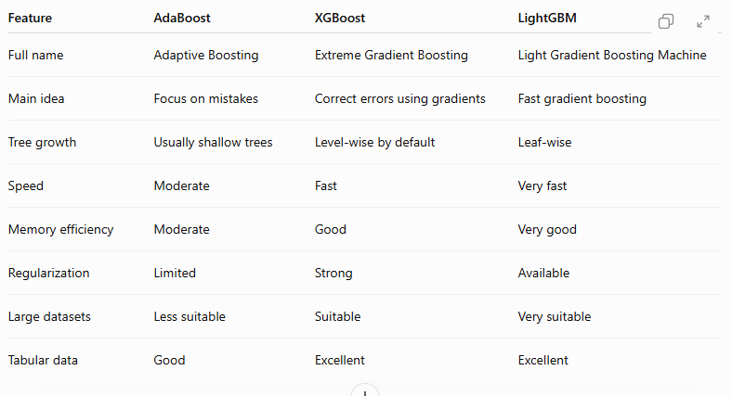
AdaBoost vs XGBoost vs LightGBM

Slide 15
Simple Difference
Remember it like this:
AdaBoost
"Focus on the difficult examples."
XGBoost
"Correct the previous errors using gradients."
LightGBM
"Do gradient boosting quickly and efficiently."
This is a very good slide to remember for your presentation.

Slide 16
Thank You

